Slide 1

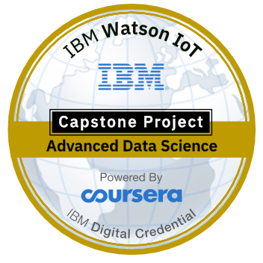
Opening a new shopping mall in Bangalore, India
IBM Capstone project.

Slide 2
Objective
To analyze and select the best locations in the city of Bangalore, India to open a new shopping mall.
Using data science methodology and machine learning techniques like clustering, this project aims to provide solutions to answer the business question: In the city of Bangalore, India, if a property developer is looking to open a new shopping mall, where would you recommend that they open it?

Slide 3
Methodology
Web scraping data (to get list of neighborhood)
Geocoder package (to convert address into geographical coordinates)
Folium package (Visualization in a map)
Foursquare API (to get venue data by making API calls)
K means clustering

Slide 4
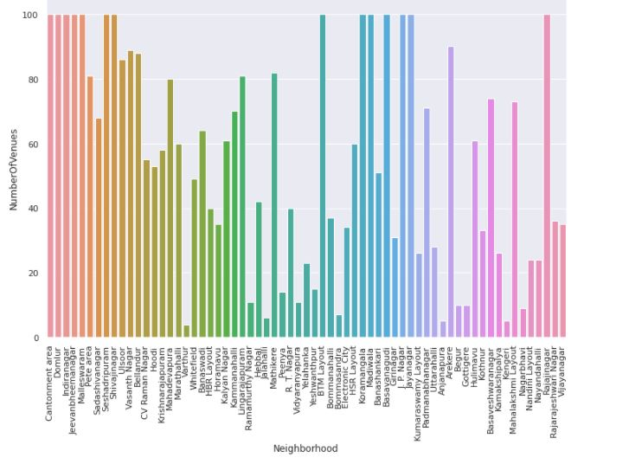
Exploratory Data Analysis based on number of venues per neighborhood

Slide 5
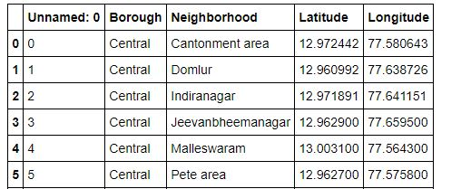
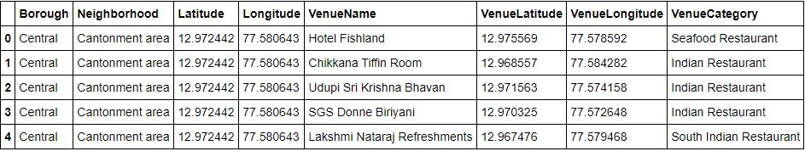
Datasets
Web scraped data
Venue data using Foursquare API

Slide 6
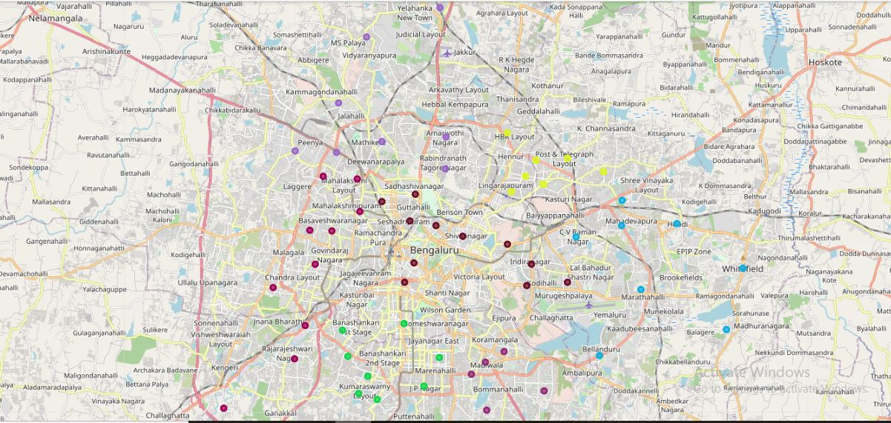
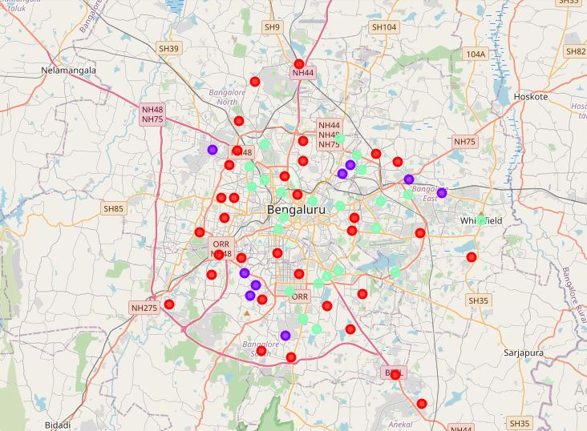
Mapping and clustering

Slide 7
Results
Cluster 0 : Neighborhoods with low or no existence of shopping malls (red color)
Cluster 1: Neighborhoods with high concentration of shopping malls (purple color)
Cluster 2: Neighborhoods with moderate number of shopping malls (mint green color)

Slide 8
Conclusion
The neighborhoods in Cluster 0 are the most preferred locations to open a new shopping mall.
The findings of this project will help the relevant stakeholders to capitalize on the opportunities on high potential locations while avoiding overcrowded areas in their decisions to open a new shopping mall.
Further research can be done by including factors such as population and income of residents.

Slide 9

Thank You!

